Slide 1

ENGINEERING CHEMISTRY
Asha A
Department of Science and Humanities

Slide 2

ENGINEERING CHEMISTRY
Module I- Molecular Spectroscopy
Class content:
Born - Oppenheimer approximation
Energy level diagram of a diatomic molecule
Introduction to rotational spectroscopy
Expression for Moment of inertia for homonuclear diatomic molecule

Slide 3
Different types of energies possessed by a molecule
ENGINEERING CHEMISTRY
Module I- Molecular Spectroscopy
Translational energy (E_{trans}): by virtue of translatory motion of the molecule
Rotational energy (E_{rot}) : by virtue of rotation of a molecule about its centre of gravity
Vibrational energy (E_{vib}): by virtue of periodic displacement of the atoms of a molecule about its equilibrium position
Electronic energy(E_{elec}) : due to the different electronic arrangements in the molecule

Slide 4
ENGINEERING CHEMISTRY
Module I- Molecular Spectroscopy
Born-Oppenheimer approximation
Total energy of a molecule is the sum of translational, rotational, vibrational and electronic energies, i.e.
E = E_{trans} + E_{rot} + E_{vib} + E_{elec}
Translational energy is negligibly small. Hence Born-Oppenheimer approximation can be written as
E = E_{rot} + E_{vib} + E_{elec}
Electronic, vibrational and rotational energies of a molecule are completely independent of each other
Because the electronic energy levels are much farther apart than the vibrational energy levels which are again much farther apart than the rotational energy levels
Can be written as
E_{rot} << E_{vib} << E_{elec}

Slide 5
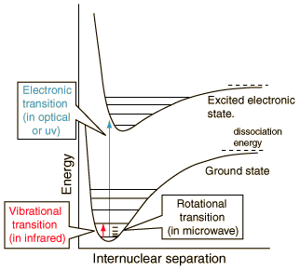
ENGINEERING CHEMISTRY
Module I- Molecular Spectroscopy
Energy level diagram for a diatomic molecule
Source:http://hyperphysics.phy-astr.gsu.edu/hbase/molecule/molec.html

Slide 6
Rotational spectroscopy
ENGINEERING CHEMISTRY
Module I- Molecular Spectroscopy
A molecule undergoing rotation absorbs in the microwave region
For a molecule to be rotationally active or microwave active the molecule has to possess a permanent dipole moment
Rotations of a molecule having permanent dipole moment will cause changes in electric dipoles that will interact with the electrical component of the electromagnetic radiation

Slide 7
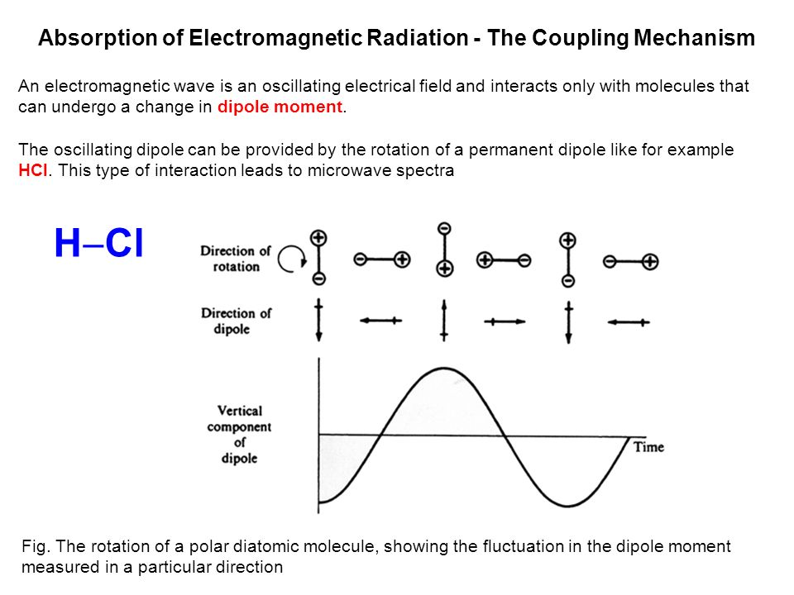
ENGINEERING CHEMISTRY
Module I- Molecular Spectroscopy
Source:Fundamentals of Molecular Spectroscopy: C. N. Banwell and Elaine M McCash, Fifth Edition, MCGRAW-HILL Education (India) Private Ltd.

Slide 8
ENGINEERING CHEMISTRY
Module I- Molecular Spectroscopy
When the frequencies match, resonance occurs and the molecule absorbs energy and goes to the higher rotational levels and a rotational spectrum can be recorded
Molecules such as HCl and CO show rotational spectra as they possess permanent dipole moment while H₂, Cl₂ and CO₂ do not

Slide 9
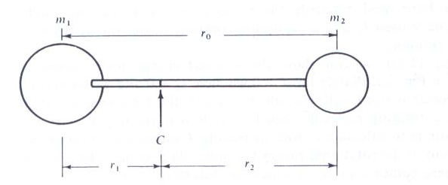
Derivation of Moment of Inertia for a heteronuclear diatomic molecule- rigid rotor model
ENGINEERING CHEMISTRY
Module I- Molecular Spectroscopy
Expressions for rotational energy levels for a diatomic molecule
Source:Fundamentals of Molecular Spectroscopy: C. N. Banwell and Elaine M McCash, Fifth Edition, MCGRAW-HILL Education (India) Private Ltd.
A rigid diatomic molecule with masses m₁ and m₂ joined by a thin rod of length r ₀ = r₁ + r₂ .The centre of mass is at C

Slide 10
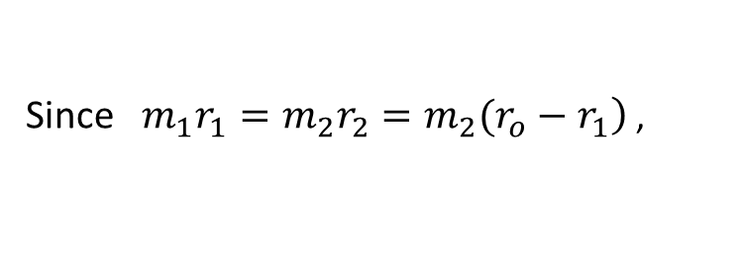
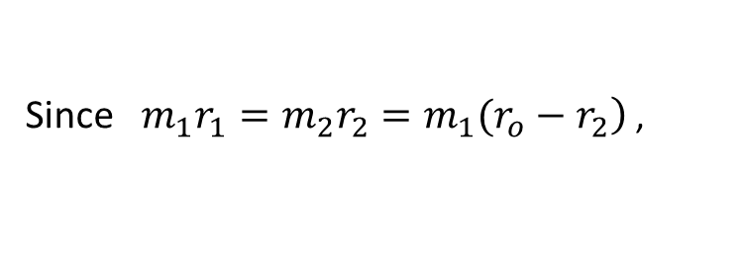
ENGINEERING CHEMISTRY
Module I- Molecular Spectroscopy
The molecule rotates end- over- end about a point C, the centre of gravity ,
this is defined by the moment, or balancing, equation:
The moment of inertia about C is defined by
I = m₁r₁² + m₂r₂²
Since $\left.m_{1}r_{1}=m_{2}r_{2}=m_{2}(r_{o}−r_{1}\right)$ ,
Since $\left.m_{1}r_{1}=m_{2}r_{2}=m_{1}(r_{o}−r_{2}\right)$ ,
Therefore
Where μ is the reduced mass given by

Slide 11
THANK YOU
Asha A
Department of Science and Humanities

